Slide 1
WGCNA in amygdala
29th May 2026

Slide 2
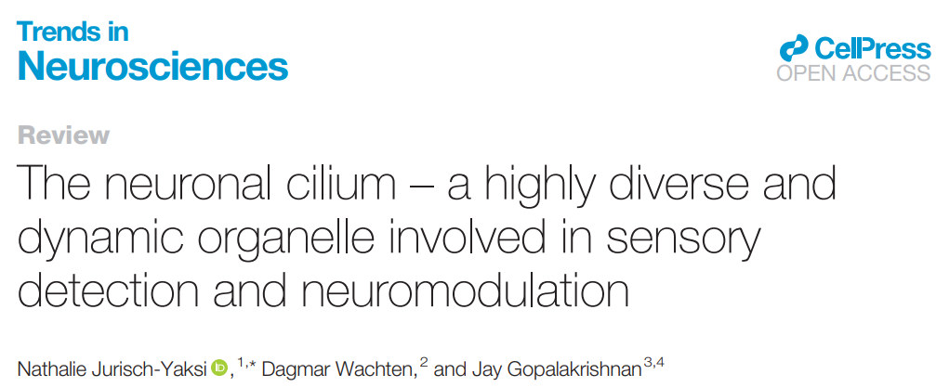
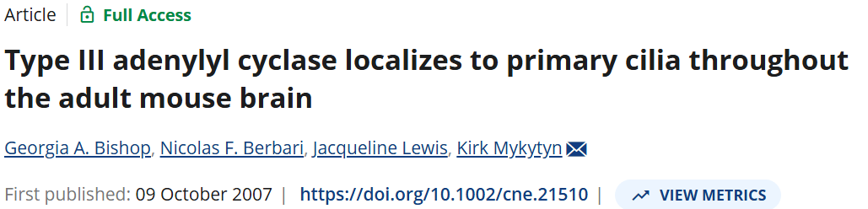
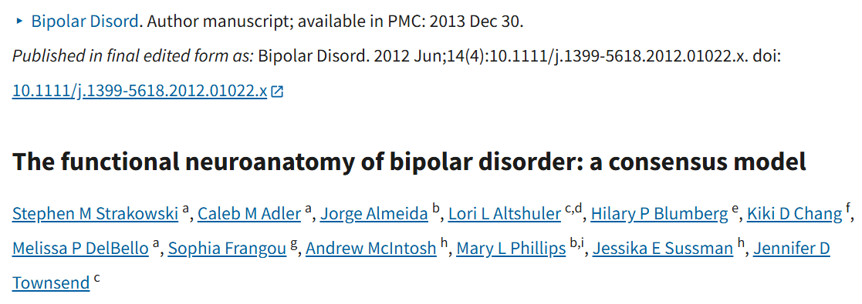
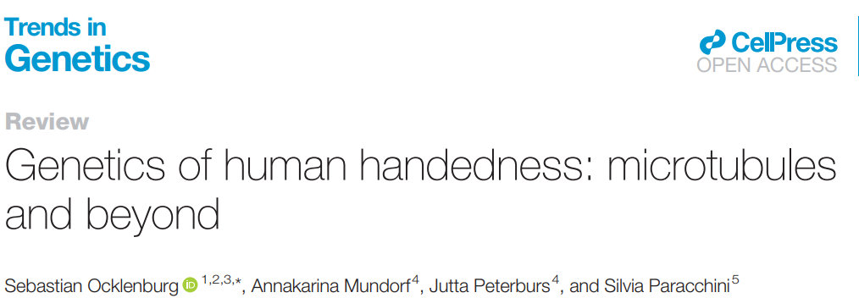
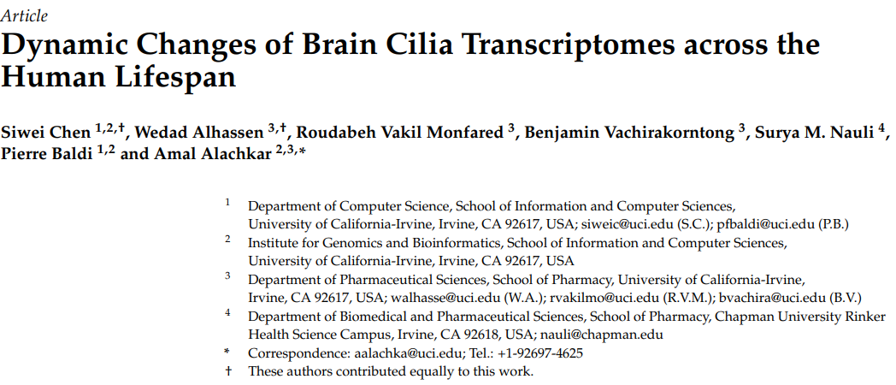
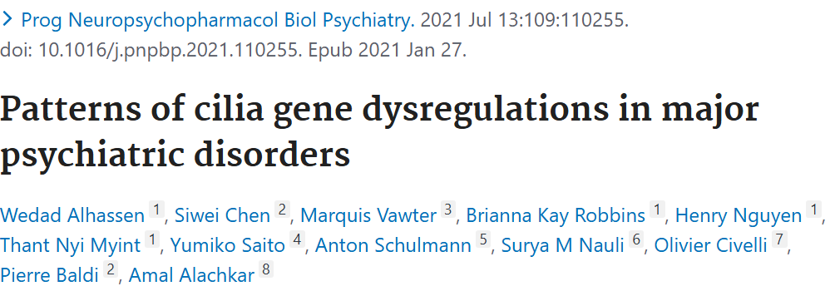
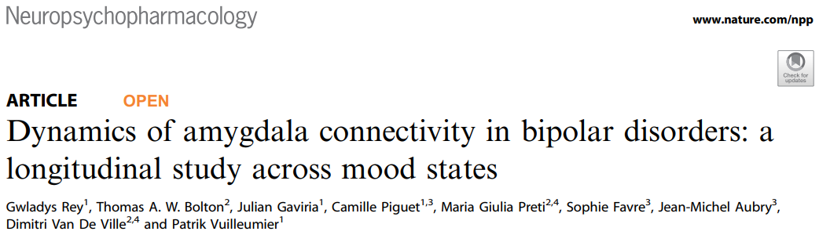
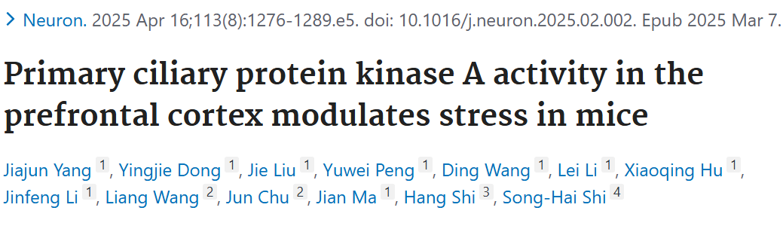
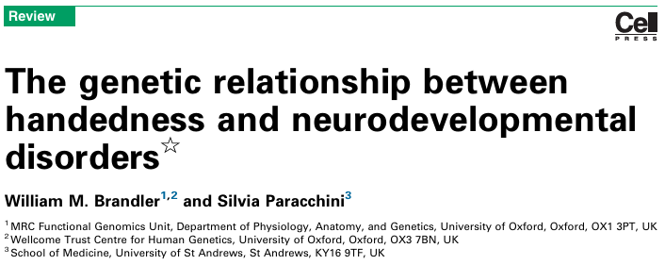
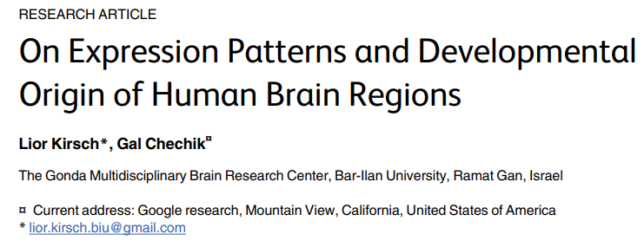
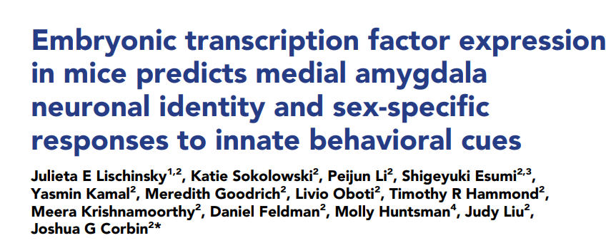
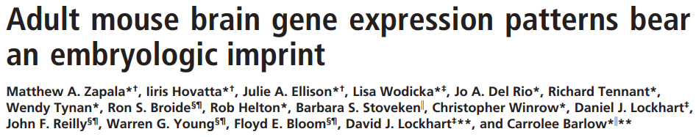
Why amygdala?
Cilia in brain + limbic system (amygdala)
Amygdala is an interesting structure in BD
Genetics handedness
Handedness mechanisms
The amygdala is highly enriched in cilia-dependent signaling pathways involved in neuronal plasticity and emotional processing, while simultaneously retaining transcriptional programs that reflect embryonic developmental patterning, suggesting persistence of fetal laterality-related molecular mechanisms into adulthood.
Neurodevelopmental imprinting in amygdala
Neurodevelopment

Slide 3
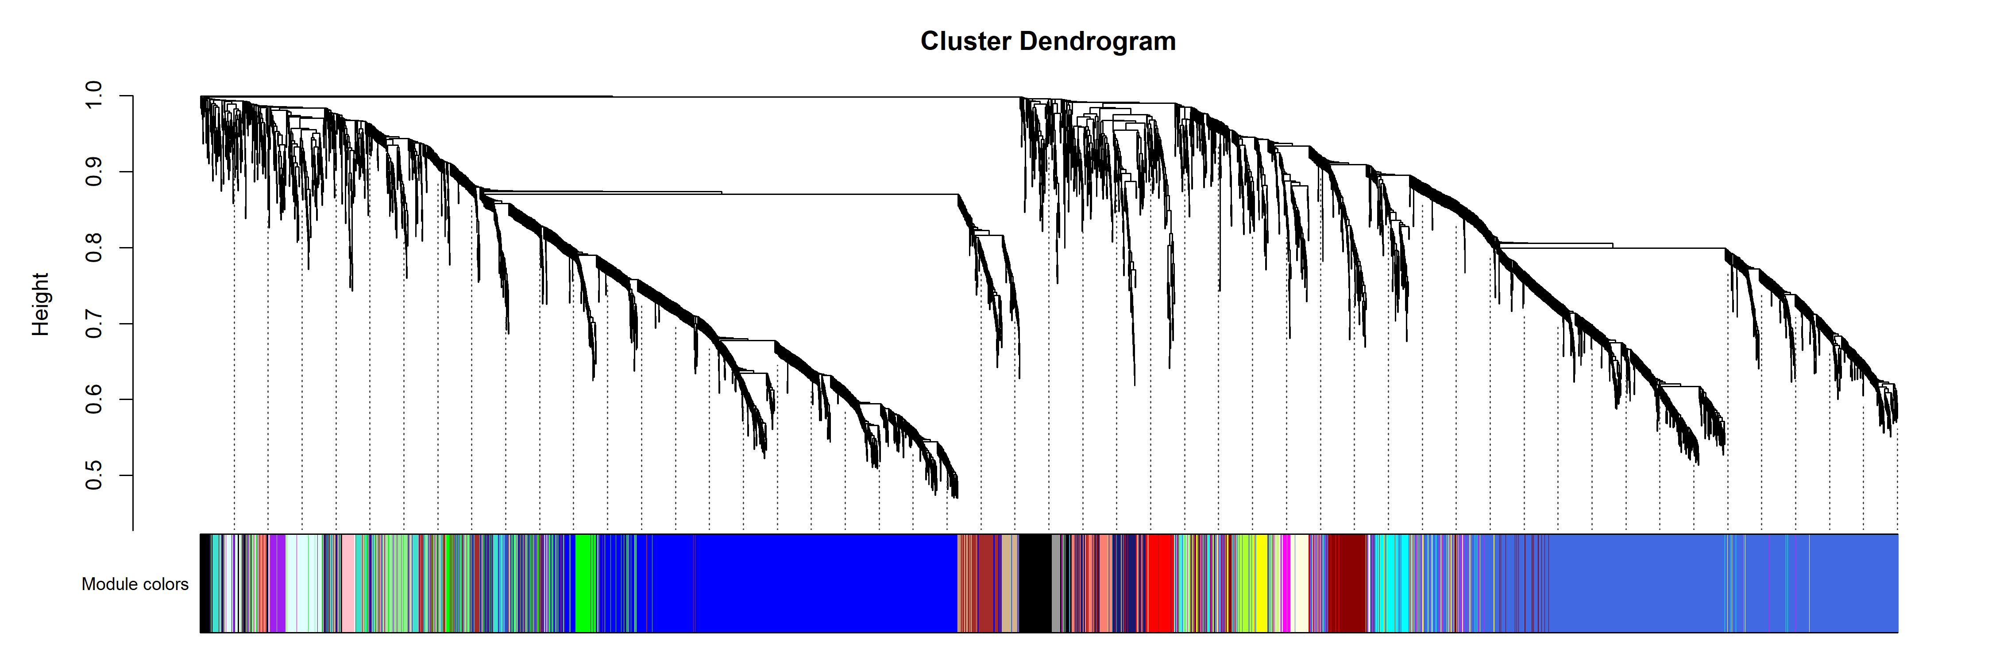
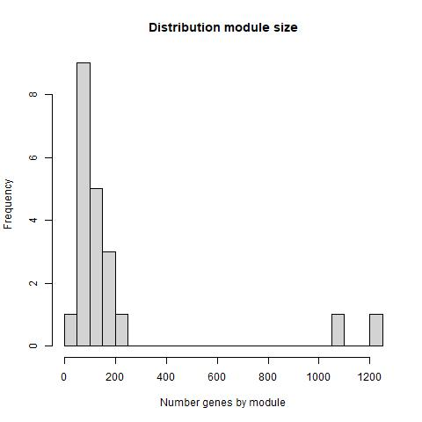
Automatic net construction minMod = 15 softThr = 20
Less tan 9K genes imputed.
21 modules.
MidnightBlue and Red significantly enriched in cilia and microtubules categories.

Slide 4
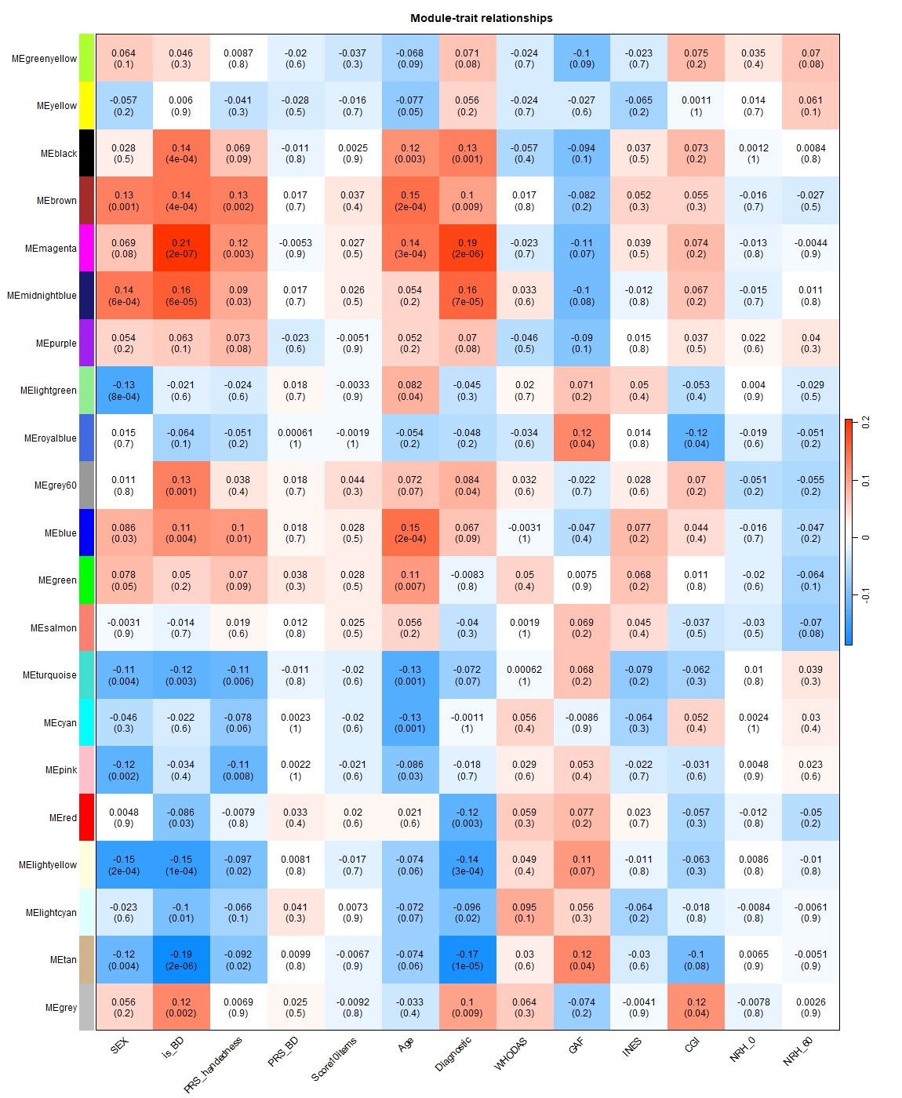
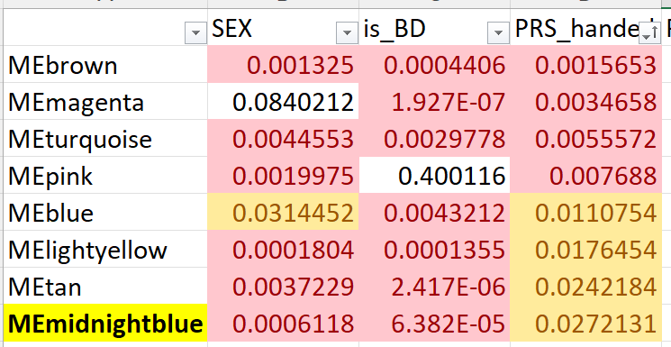
Module-trait correlation
No modules correlated to NRH.
8 modules correlated to PRS handedness, 7 in common to BD (P-val in table).
Midnightblue correlated to PRS handedness, BD and SEX is significantly enriched in cilia formation.
Red, also enriched in cilia + microtubules, only correlated to BD.
Poor intramodular analysis (not the best WGCNA ever run)

Slide 5
Conclusions on amygdala
Attemp to justify amygdala close-up.
WGC net was not optimized in manual construction, leading to inefficient modules
There is no gene-expression module that is associated to left-handedness: there is only some signal when looking at the genetic burden, not to the phenotype itself.
There are two distinct modules related to 2013 Silvia theory, one linked to PRS of handedness and sex, one that is only related to SCZ.

